Slide 1

Big Data Storage
Hadoop Distributed file System(HDFS)

Slide 2
Architecture and Data Blocks
HDFS

Slide 3

Hadoop
To achieve distributed computing
1
2
3
Cluster
4
5
6

Slide 4
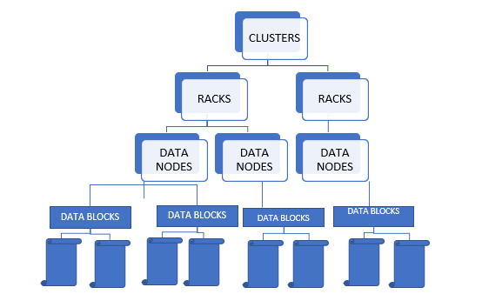
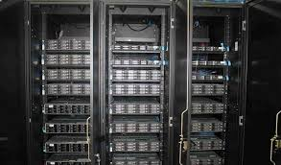
BIG DATA
HDFS – Hadoop distributed File system
https://medium.com/@Meela349588204/rack-server-vs-blade-server-d1b5aee58ca2

Slide 5
HDFS Architecture
Designing considerations
NodNode 1
Cluster
NodNode 2
Separation of metadata and File Data
Metadata:
File name, Access Control information, Size and location
Not frequently accessed so keep it in a separate medium
3. File Data:
Actual data so more time spent here
NodNode 3
NodNode 4
NodNode 5

Slide 6


HDFS Architecture
Master Slave Architecture
One node of a cluster acts as a Master Node called as Name Node.
Manages the entire file system.
The directory structure and the Metadata.
This information is stored persistently on the local disk in the form of two files:
the namespace image (Fsi Image)
edit log

Slide 7
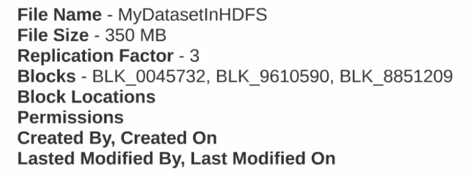
BIG DATA
Namenode organization
FSImage
Edit Log
Serialized form of filesystem tree
Not updated on every write
To avoid recopy of data
Stores
Filename
access time
#blocks
blocks consisting the file
Every write first writes to edit log
Flushed and synced after every transaction
Append only operation
Since no modify operation is done on either file, it can be done really fast.

Slide 8
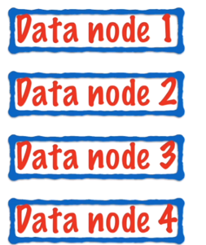
HDFS Architecture
Master Slave Architecture
All other nodes apart from Name Node are called as Data Nodes
They hold the actual data.

Slide 9
HDFS Internals
Name Node
How to identify Name Node memory requirements?
Example calculation
200 node cluster
24TB/node
128MB block size
Replication factor = 3

Slide 10
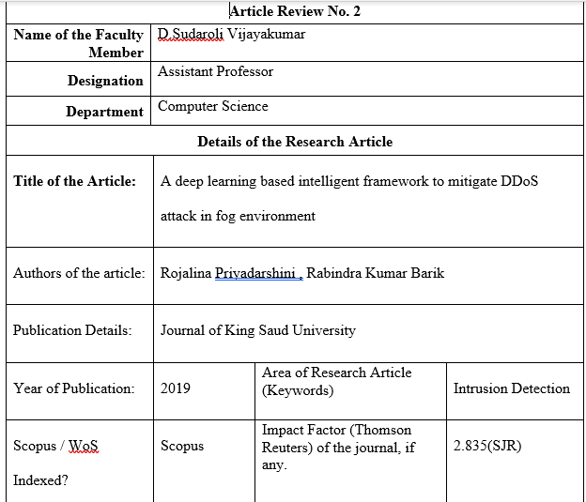
HDFS Architecture
So How does data get stored in HDFS?
Let's assume our data is in the form of large text file
Block 1
Block 1
Blocks are the smallest continuous location on your hard drive where data is stored.
HDFS stores each file as blocks, and distribute it across the Hadoop cluster.
The default size of a block in HDFS is 128 MB (Hadoop 2.x) and 64 MB (Hadoop 1.x) which is much larger as compared to the Linux system where the block size is 4KB
The reason of having this huge block size is to minimize the cost of seek and reduce the meta data information generated per block.
Block 2
Block 3
Block 4
Block 5

Slide 11
HDFS Architecture
Exercise
Suppose there is file of size 514 MB stored in HDFS (Hadoop 2.x) using default block size configuration and default replication factor=3. Then, how many blocks will be created in total and what will be the size of each block?
Answer
Default block size in Hadoop 2.x is 128 MB. So, a file of size 514 MB will be divided into 5 blocks ( 514 MB/128 MB) where the first four blocks will be of 128 MB and the last block will be of 2 MB only. Since, we are using the default replication factor i.e. 3, each block will be replicated thrice. Therefore, we will have 15 blocks in total where 12 blocks will be of size 128 MB each and 3 blocks of size 2 MB each.

Slide 12
HDFS Blocks
Question
Do I have an option to change the block size?

Slide 13
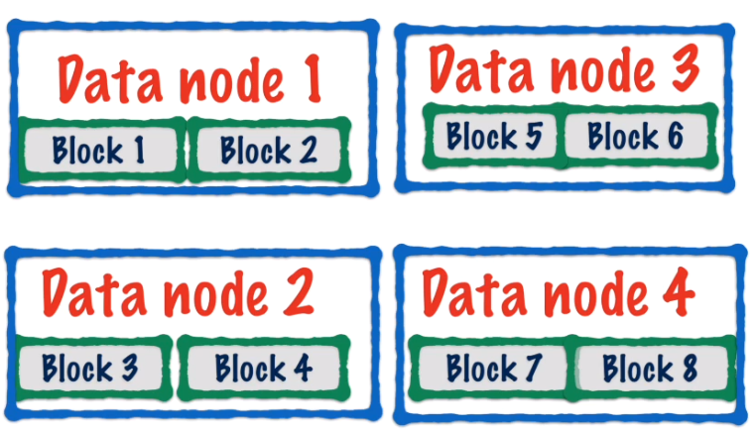
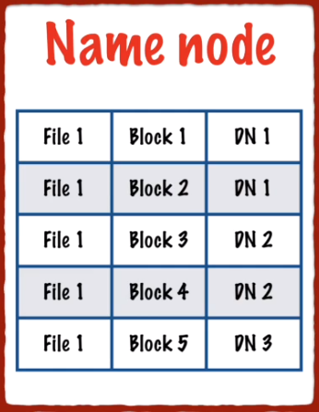
HDFS architecture
How the file gets stored in HDFS?
Block locations are stored in Name node

Slide 14
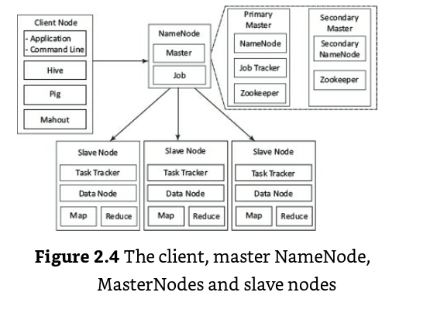
BIG DATA
HDFS – Master Slave Architecture
Client
HDFS Master :Namenode
HDFS Slaves : Datanodes
Diagram Courtesy: Big Data Analytics (Kindle Location 2502). McGraw Hill Education. Kindle Edition.

Slide 15
THANK YOU
“WORLD IS ONE BIG DATA PROBLEM”
“TORTURE THE DATA AND IT WILL CONFESS TO ANYTHING”

